Slide 1
Programming II
(C Programming Language)
Course Overview & Introduction to C
Lecture 1, Monday January 25, 2021
Dr. Ayman ALJARBOUH

Slide 2
Outline
Course Overview
Introduction to C Language

Slide 3
Course Contents

Slide 4
Outline
Course Overview
Introduction to C Language

Slide 5
What is a Computer Program?
A computer program is a collection of instructions that perform a specific task when executed by a computer
A computer program is usually written by a programmer in a programming language
There are many programming languages, such as C, C++, Pascal, BASIC, FORTRAN, COBOL, LIS, and many others. These are all high-level languages
One can also write programs in low-level languages called assembly languages, although this is more difficult

Slide 6
Classification of Programming Languages
Computer language can be categories into three categories:
Machine Level Language:
Code is in the form of 0 and 1
Not portable, difficult to maintain and error prone
Assembly Level Language:
Instructions are given in English like word as ADD, SUM, MOV etc
Easy to write and understand but not understand by the machine
High Level Language:
Much easier to write a program than the low level language
C language is a high level language that can be used for almost any programming task

Slide 7
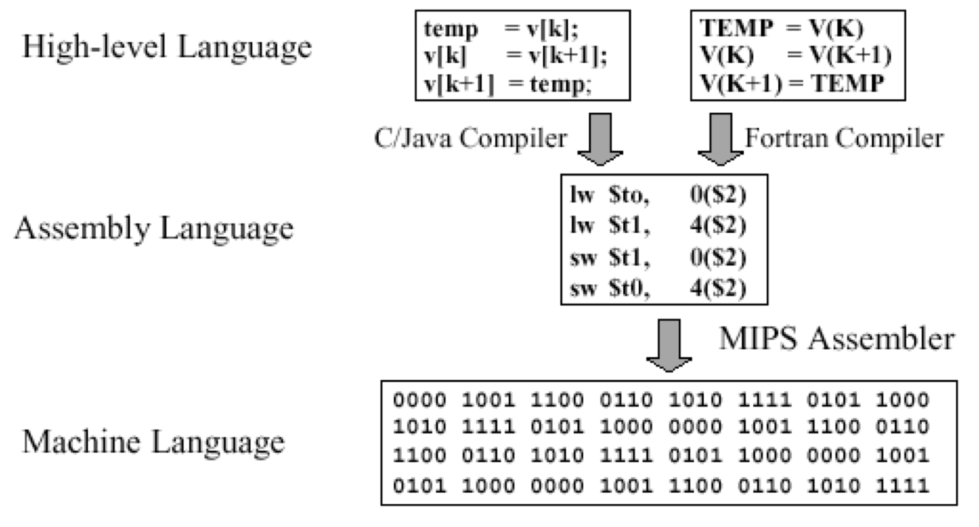
Classification of Programming Languages

Slide 8
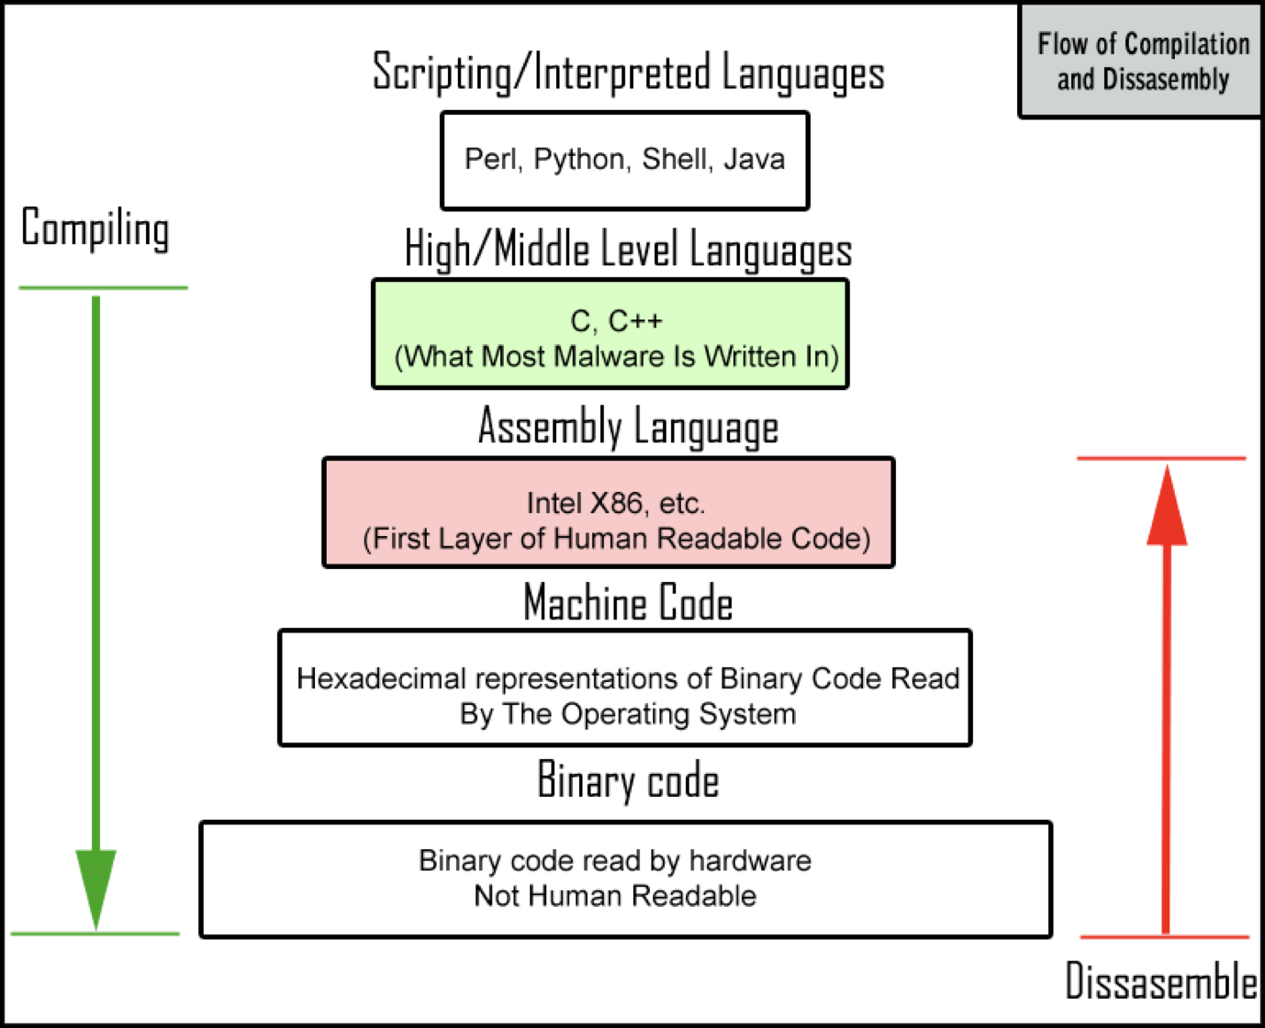
Classification of Programming Languages

Slide 9
Classification of Programming Languages
High-level Language | Low-level Language
Easy to learn | Difficult to learn
Near to human languages. | Far from human languages.
Programs are slow in execution | Programs are fast in execution
Programs are easy to modify | Programs are difficult to modify
Do not provide much facility at hardware level | Provide facility to write programs at hardware level
Knowledge of hardware is not required | Deep knowledge of hardware is required
Used to write application programs | Used to write hardware programs

Slide 10


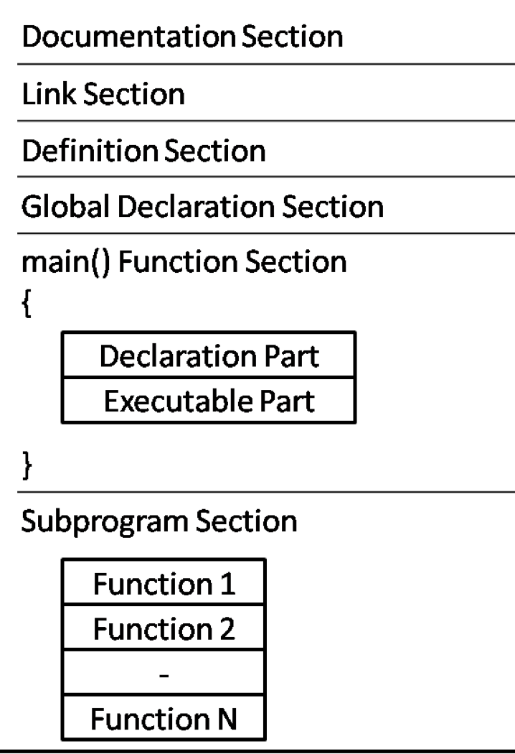
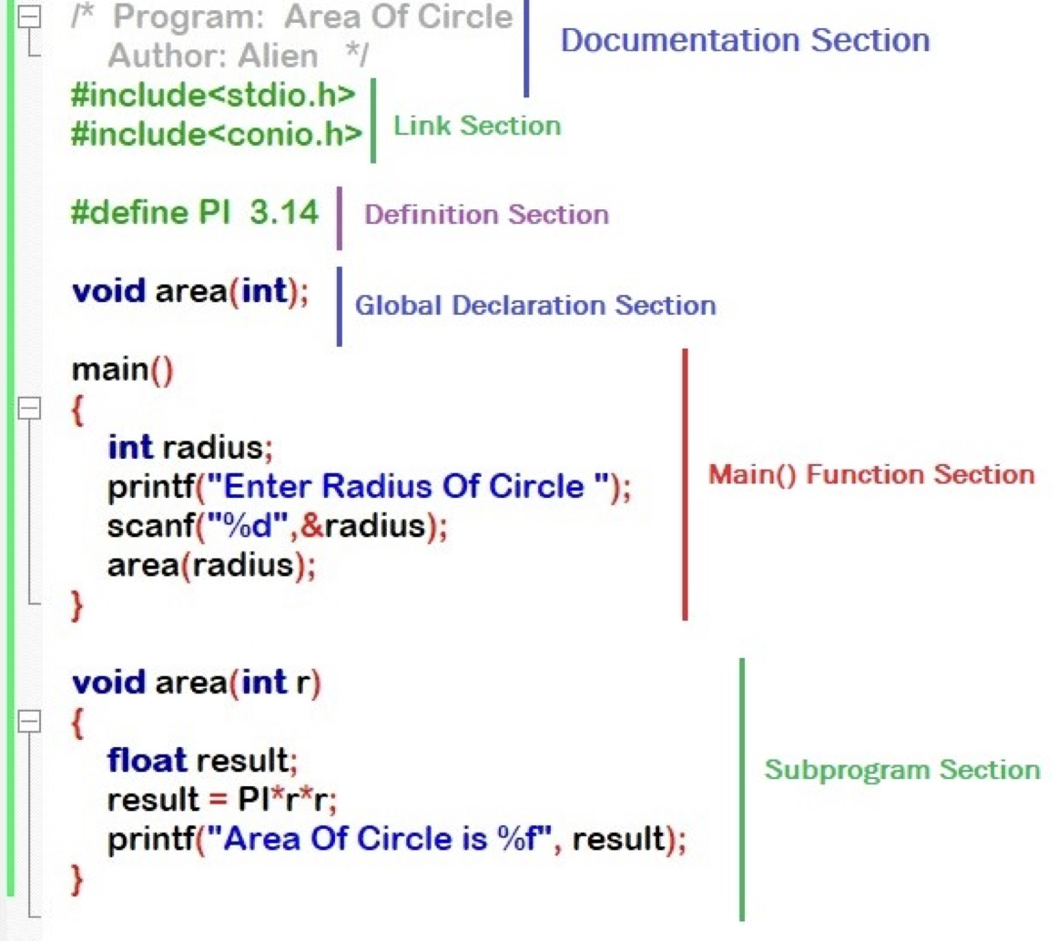
C Program Structure
C Program Structure
Example

Slide 11
C Program Structure
A C program basically has the following form:
Comments:
Used to give additional useful information inside a C Program
All the comments will be put inside /*...*/
Pre-processor Commands:
They tell the compiler to do pre-processing before doing actual compilation
Functions:
Every C Program will have one or more functions
There is one mandatory function which is called main() function

Slide 12
C Program Structure
A C program basically has the following form:
Variables:
Used to hold numbers, strings and complex data for manipulation
Statements & Expressions:
Expressions combine variables and constants to create new values
Statements are expressions, assignments, function calls, or control flow statements which make up C programs
Note:
C language is a case sensitive programming language. It means in C, printf() and Printf() will have different meanings
End of each C statement must be marked with a semicolon (;)
Multiple statements can be written in the same line

Slide 13
C Program Structure
A C program basically has the following form:
Variables:
Used to hold numbers, strings and complex data for manipulation
Statements & Expressions:
Expressions combine variables and constants to create new values
Statements are expressions, assignments, function calls, or control flow statements which make up C programs
Note:
C White Spaces (tab space and space bar) are ignored
Statements can continue over multiple lines

Slide 14
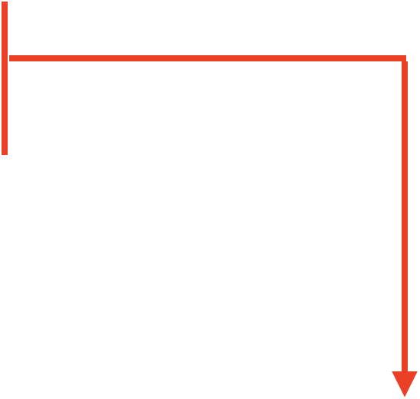
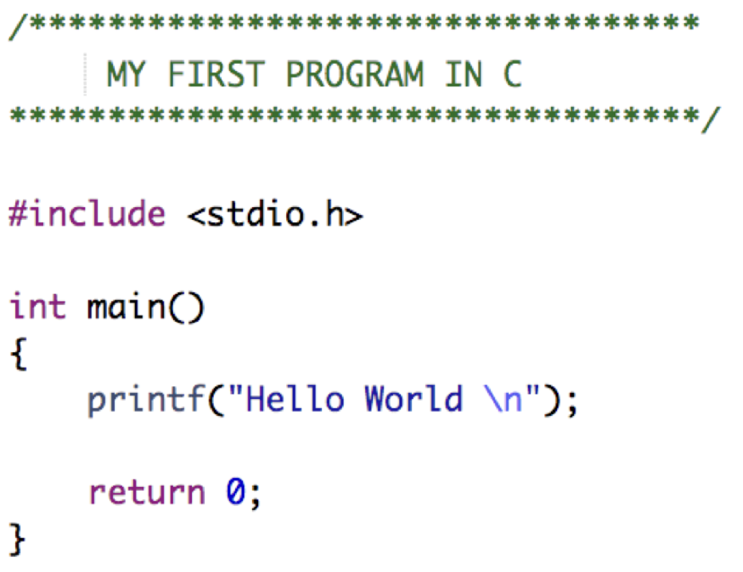
C Program Structure
A code that would print the words “Hello World” looks like:
Example
The text inside /*...*/ will be ignored by the compiler and it has been put to add additional comments in the program. So such lines are called comments in the program

Slide 15

C Program Structure
A code that would print the words “Hello World” looks like:
Example
The first line of the program #include <stdio.h> is a pre-processor command, which tells a C compiler to include stdio.h file before going to actual compilation. we are using printf() from stdio.h header file

Slide 16
C Program Structure
A code that would print the words “Hello World” looks like:
Example
The next line int main() is the main function where the program execution begins. The curly open and close braces {} define the scope of the main() function, means main() function’s boundaries

Slide 17

C Program Structure
A code that would print the words “Hello World” looks like:
Example
The next line printf(...) is another function available in C which causes the message “Hello World” to be displayed. All program statements in C must be terminated by a semicolon ;

Slide 18
C Program Structure
A code that would print the words “Hello World” looks like:
Example
The next line return 0; terminates the main() function and returns the value 0

Slide 19
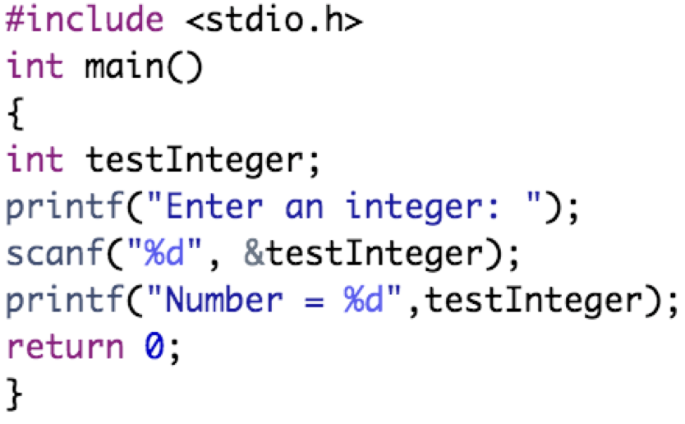
C Input
In C programming, scanf() is used for C input. To use scanf(), we need to include stdio.h header file
Integer Input: We use %d format specifier inside the scanf() function to take int input from the user
Example:
In this example:
We have used &testInteger inside scanf(). It is because &testInteger gets the address of testInteger, and the value entered by the user is stored in that address

Slide 20
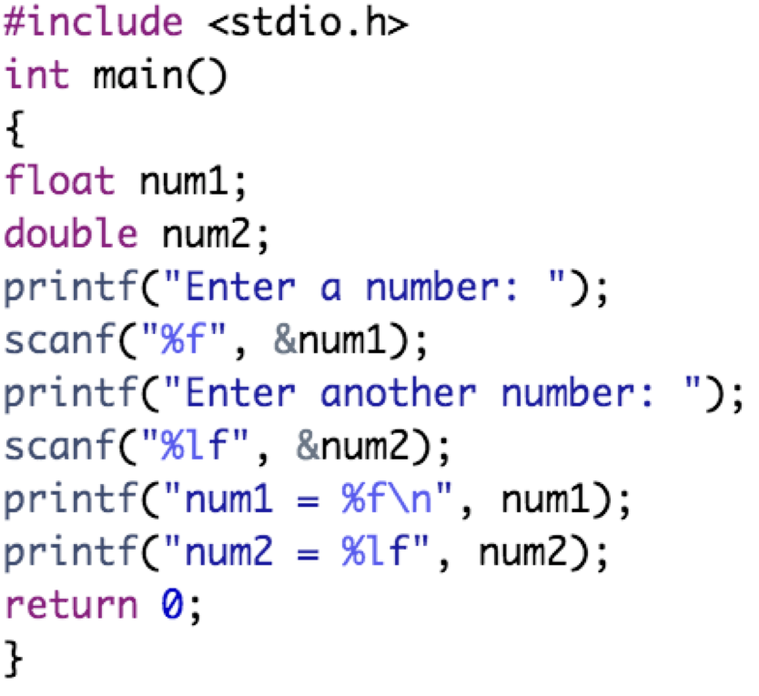
C Input
In C programming, scanf() is used for C input. To use scanf(), we need to include stdio.h header file
Float & Double Input: We use %f and %lf format specifier for float and double, respectively
Example:

Slide 21
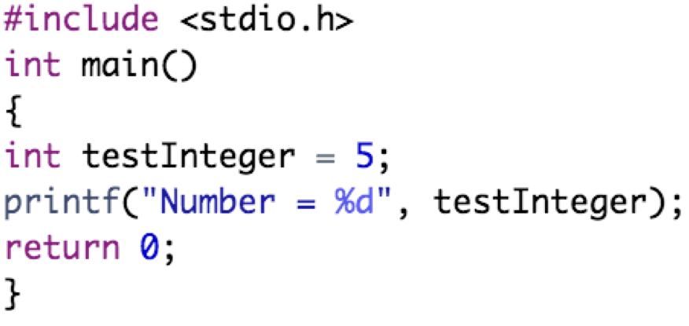
C Output
In C programming, printf() is used for C output. The function printf() displays formatted output on the screen. To use printf(), we need to include stdio.h header file
Integer Output: We use %d format specifier inside the printf() function to print int values
Example:

Slide 22
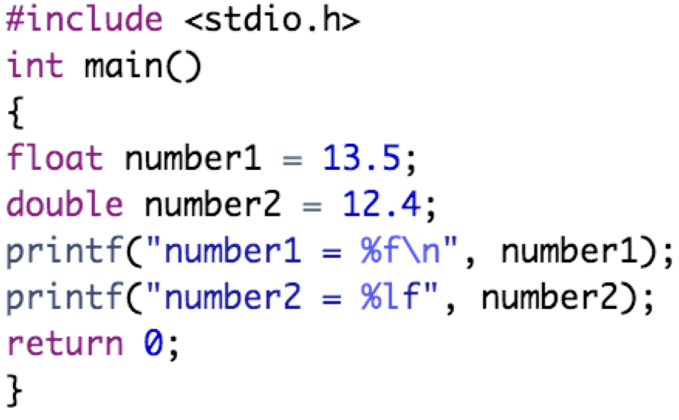
C Output
In C programming, printf() is used for C output. The function printf() displays formatted output on the screen. To use printf(), we need to include stdio.h header file
Float & Double Output: We use %f and %lf format specifier for float and double, respectively
Example:

Slide 23
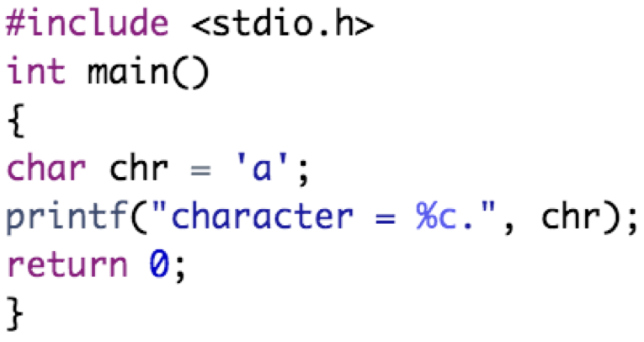
C Output
In C programming, printf() is used for C output. The function printf() displays formatted output on the screen. To use printf(), we need to include stdio.h header file
Char Output: To print char variables, we use %c format specifier
Example:

Slide 24
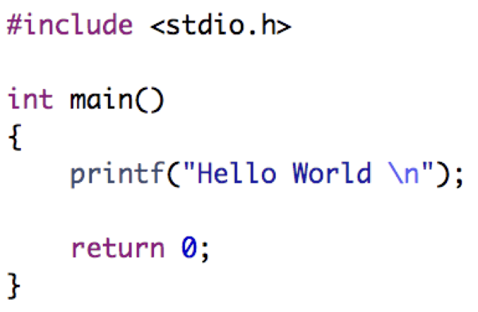
Practical Exercises
Write and Compile the following C programs:
Program 1:

Slide 25

Practical Exercises
Write and Compile the following C programs:
Program 2:

Slide 26

Practical Exercises
Write and Compile the following C programs:
Program 3:

Slide 27
Practical Exercises
Write and Compile the following C programs:
Program 4:

Slide 28

Practical Exercises
Write and Compile the following C programs:
Program 5:

